Slide 1
JavaScript

Slide 2
Introduction
JavaScript is a lightweight, interpreted programming language.
JavaScript is a scripting language of the Web.
commonly used to create dynamic and interactive elements in web applications.
It is open and cross-platform.
High level: it provides abstractions that allow you to ignore the details of the machine where it's running on.
Dynamic: executes at runtime many of the things that a static language does at compile time.
It is a dynamically typed programming language, which means that we don’t care about variable data types while writing the JavaScript code.

Slide 3
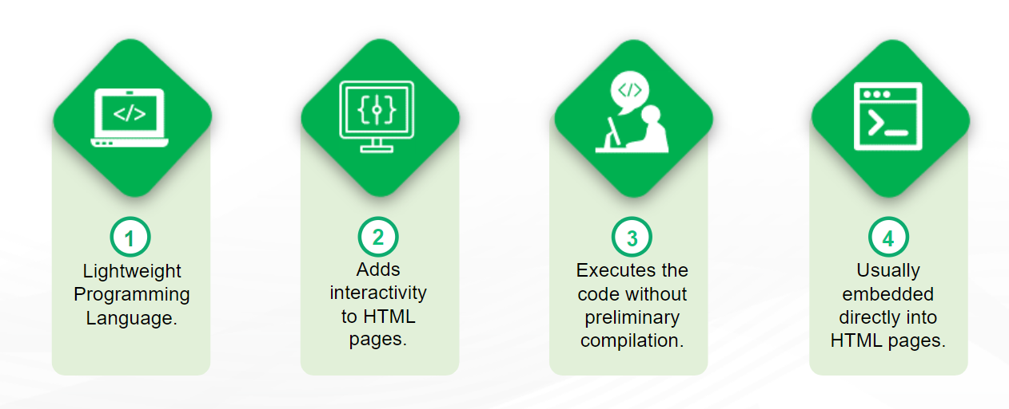
Introduction

Slide 4
Are Java and JavaScript the same?
NO!
Java and JavaScript are two completely different languages in both concept and design!
Java (developed by Sun Microsystems) is a powerful and much more complex programming
language - in the same category as C and C++.

Slide 5
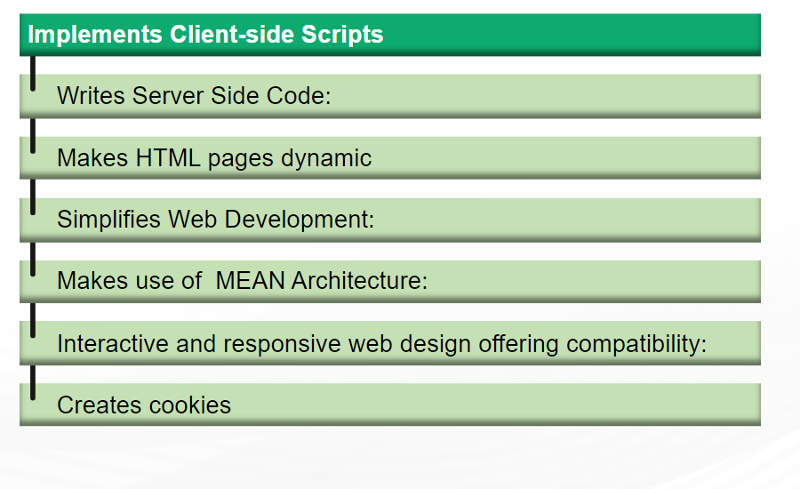
What can a JavaScript do?

Slide 6
What can a JavaScript do?
JavaScript gives HTML designers a programming tool - HTML authors are normally not programmers, but JavaScript is a scripting language with a very simple syntax! Almost anyone can put small "snippets" of code into their HTML pages
JavaScript can put dynamic text into an HTML page - A JavaScript statement like this: document.write(“<h1>" + name + “ </h1>") can write a variable text into an HTML pag
JavaScript can react to events - A JavaScript can be set to execute when something happens, like when a page has finished loading or when a user clicks on an HTML element
JavaScript can read and write HTML elements - A JavaScript can read and change the content of an HTML element
JavaScript can be used to validate data - A JavaScript can be used to validate form data before it is submitted to a server. This saves the server from extra processing
JavaScript can be used to detect the visitor's browser - A JavaScript can be used to detect the visitor's browser, and - depending on the browser - load another page specifically designed for that browser
JavaScript can be used to create cookies - A JavaScript can be used to store and retrieve information on the visitor's computer

Slide 7
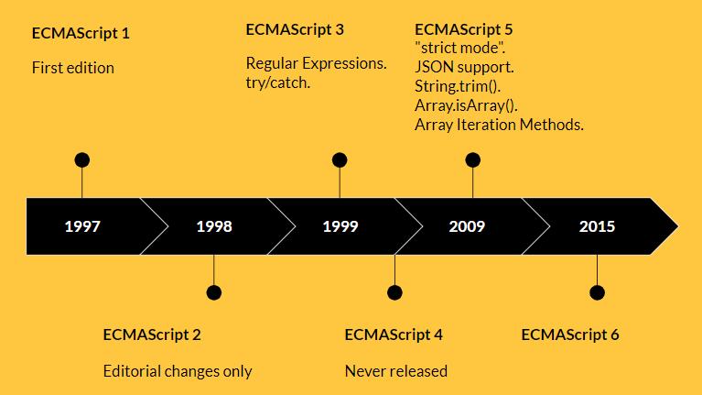
History of ECMAScript (ES) and JavaScript
JavaScript: A scripting language developed by Netscape in 1995, primarily for web browsers.
ECMAScript (ES): A standardized scripting language specification on which JavaScript is based.
ECMA International: The organization responsible for standardizing JavaScript through ECMAScript.
The development of the standard is still in progress.

Slide 8
JavaScript Features
Browser Support: All browsers support JavaScript, as all modern browser comes with the built-in JavaScript execution environment
DOM Manipulation: JavaScript allows developers to manipulate the webpage elements. Also, you can control the browser.
Event Handling: JavaScript allows you to handle the events used to interact with the web page.
Dynamic Typing: JavaScript decides the type of variables at runtime. So, we don’t need to care about variable data type while writing the code, providing more flexibility to write code.
Functional Programming: JavaScript supports the functional programming.
Cross-platform Support: Each operating system and browser support JavaScript.
Built-in Objects: JavaScript contains built-in objects like Math and Date.
Built-in Methods: JavaScript also contains the built-in methods for each object.
Modular Programming: JavaScript allows you to write the code in different modules and connect them with the parent module.

Slide 9
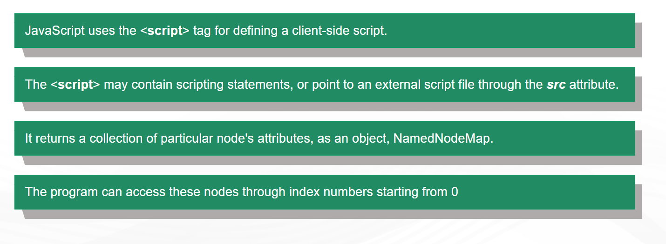
JavaScript with HTML Attribute

Slide 10
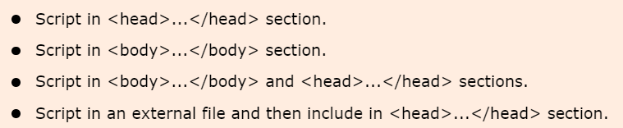
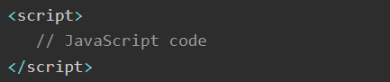
JavaScript - Placement
JavaScript Placement in HTML Fille

Slide 11
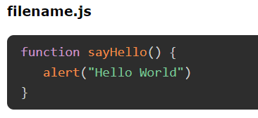
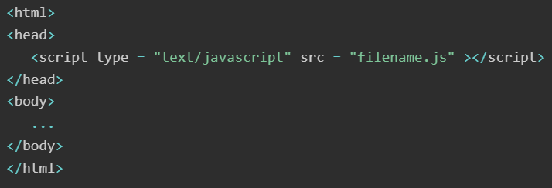
JavaScript in External File
The script tag also provides a mechanism to store JavaScript in an external file and then include it in your HTML files.
Save the external JavaScript file with a .js file extension
External JavaScript file doesn’t contain the <script> tag.
To use the external script, point to the .js file in the "src" attribute of the <script> tag:

Slide 12
JavaScript Statements
JavaScript is a sequence of statements to be executed by the browser.
JavaScript is case sensitive.
It is normal to add a semicolon at the end of each executable statement.
JavaScript statements can be grouped together in blocks. Blocks start with a left curly bracket {, and ends with a right curly bracket }
Comments can be added to explain the JavaScript, or to make the code more readable.
Single line comments start with //
Multi line comments start with /* and end with */

Slide 13
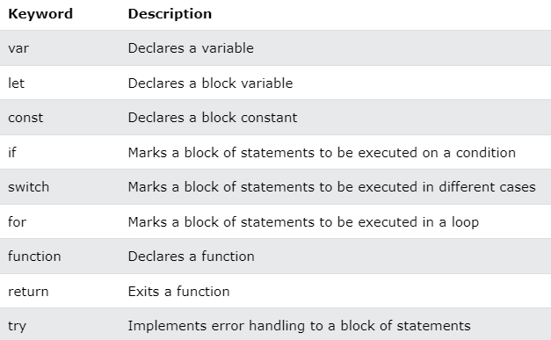
JavaScript Keywords

Slide 14
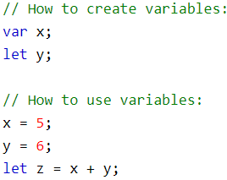
JavaScript Syntax
JavaScript syntax is the set of rules, how JavaScript programs are constructed.
JavaScript Values: The JavaScript syntax defines two types of values:
Fixed values are called Literals. (Numbers:10.50, 1001, Strings: "John Doe“, 'John Doe‘)
Variable values are called Variables.
JavaScript Comments
Single line comments start with //
Multi-line comments start with /* and end with */.

Slide 15
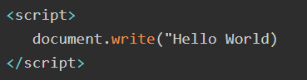
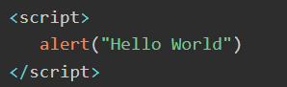
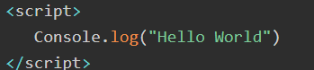
document.write()
The document.write() method writes the content (a string of text) directly to the HTML document or web page.
document.write() should be written within the <script> and </script> tags
alert()
The alert() is a window method that instruct the browser to display an alert box with the message.
console.log()
The console.log() is a very convenient method to print the message to web Console.

Slide 16
JavaScript Variable
Variables are "containers" for storing information.
JavaScript variables are used to hold values or expressions.
Variable names are case sensitive (y and Y are two different variables)
Variable names must begin with a letter or the underscore character.
Variable can be declare in 4 ways −
Without using any keywords.
Using the 'var' keyword: original way to declare a variable. Function-scoped and can be re-declared.
Using the 'let' keyword: Introduced in ES6 (ES2015). Block-scoped and cannot be re-declared within the same scope.
Using the 'const' keyword: Also introduced in ES6. Block-scoped, but the value cannot be changed (constant).
Ex: var x, var y=6

Slide 17
JavaScript Variable Scope
The scope of a variable is the region of your program in which it is defined.
Global Variables − A global variable has global scope which means it can be defined anywhere in your JavaScript code.
Local Variables − A local variable will be visible only within a function where it is defined. Function parameters are always local to that function
Within the body of a function, a local variable takes precedence over a global variable with the same name.

Slide 18
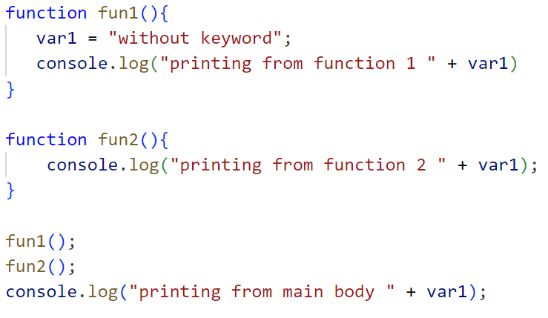
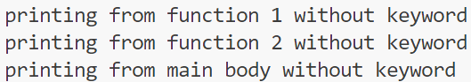
1. Declaring Variables Without a Keyword
Example: x = 10;
Automatically becomes a global variable.
Can lead to potential issues, especially in strict mode ("use strict";).
Less readable and can cause conflicts with other variables.

Slide 19
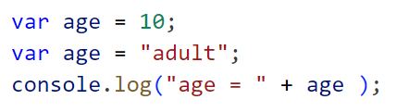
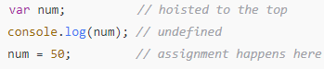
2. Declaring Variables with Keywords “var”:
Example: var x = 10;
Function-scoped or globally scoped.
Can be re-declared within the same scope.
Hoisted to the top of its scope with undefined as the initial value.
Output

Slide 20
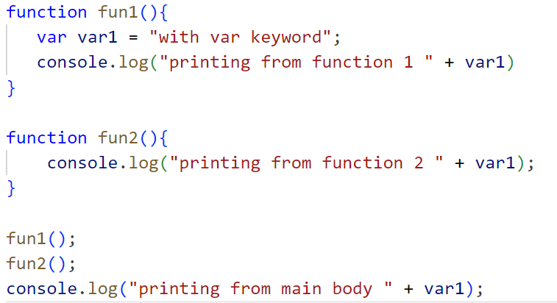
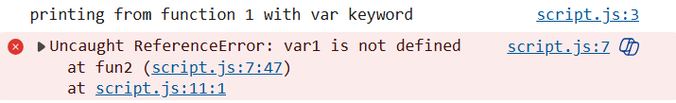

Slide 21
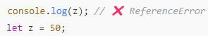
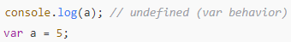
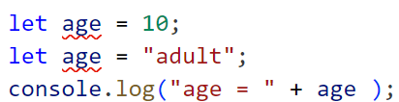
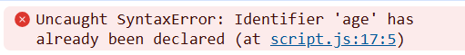
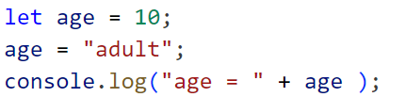
3. Declaring Variables with Keywords “let”:
Example: let x = 10;
Block-scoped (only accessible within the block {} in which it is declared).
Cannot be re-declared within the same scope. The value can be updated.
Not hoisted with initialization.
Output
Output

Slide 22
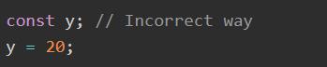
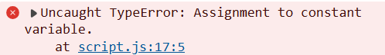
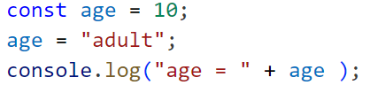
4. Declaring Variables with Keywords “const”:
Example: const x = 10;
Block-scoped like let.
Cannot be re-assigned after its initial assignment (immutable).
Must be initialized at the time of declaration.
Output

Slide 23
Key Difference
Without Keyword | var | let | const
Becomes a global variable | Function or global scope | Block scope | Block scope
Not recommended for use | Hoisted with undefined | Not hoisted with initialization | Not hoisted with initialization
Potential for conflicts | Can be re-declared | Cannot be re-declared | Cannot be re-declared
Error-prone in strict mode | Can be updated | Can be updated | Cannot be updated (constant)

Slide 24
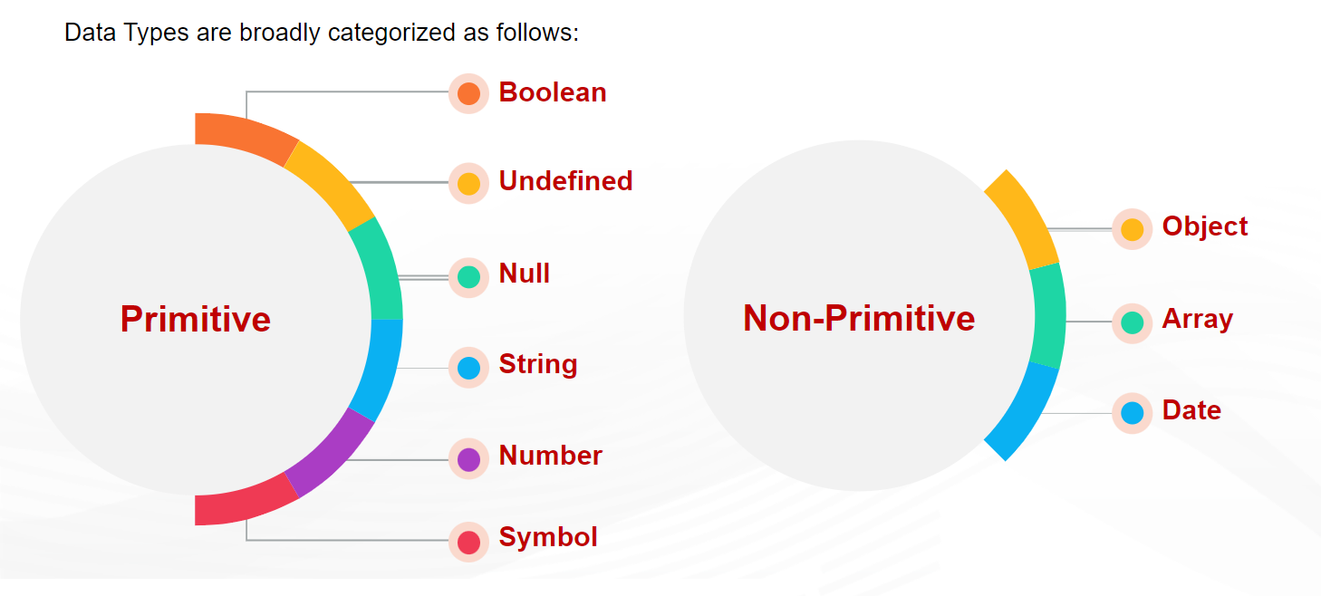
Data Types
Data types in JavaScript refer to the types of the values that we are storing or working with.
JavaScript data types can be categorized as primitive and non-primitive (object).
The Object data type contains the 3 sub-data types − Object, Array, Date

Slide 25
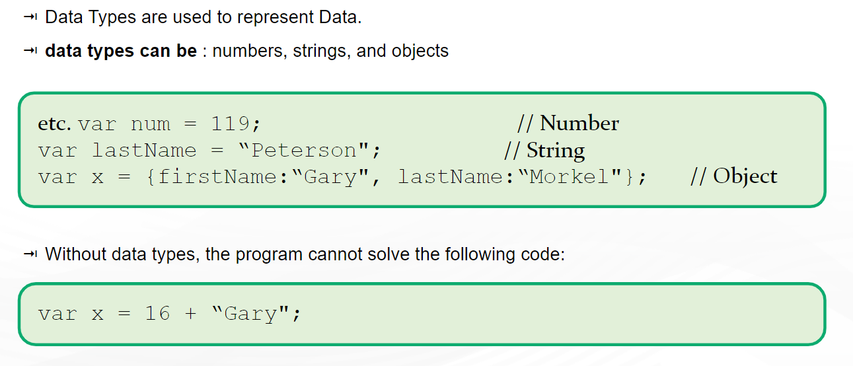
JavaScript Data Type

Slide 26
JavaScript evaluates expressions from left to right. Different sequences can produce different results
In the first example, JavaScript treats 16 and 4 as numbers, until it reaches "Volvo".
In the second example, since the first operand is a string, all operands are treated as strings.
JavaScript Types are Dynamic
JavaScript has dynamic types. This means that the same variable can be used to hold different data types.

Slide 27
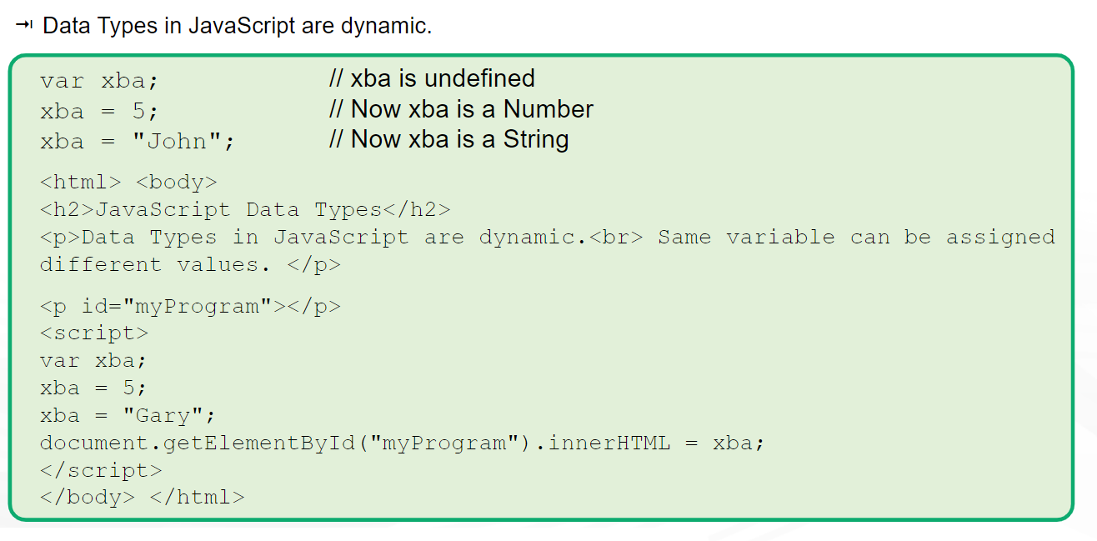

Slide 28
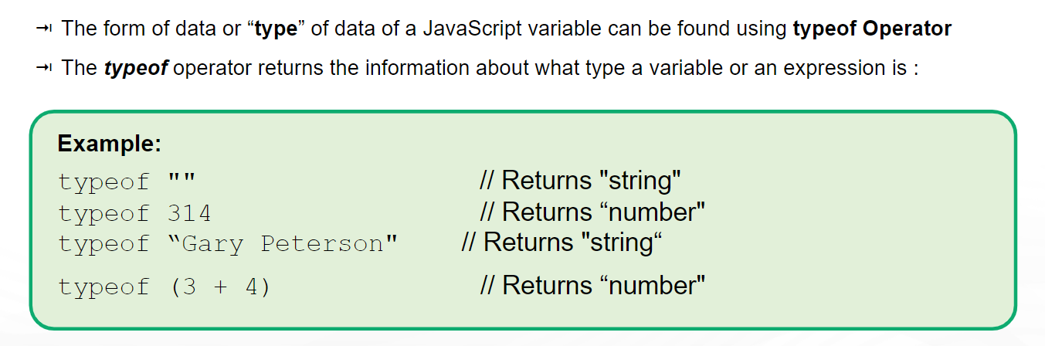
typeof Operator

Slide 29
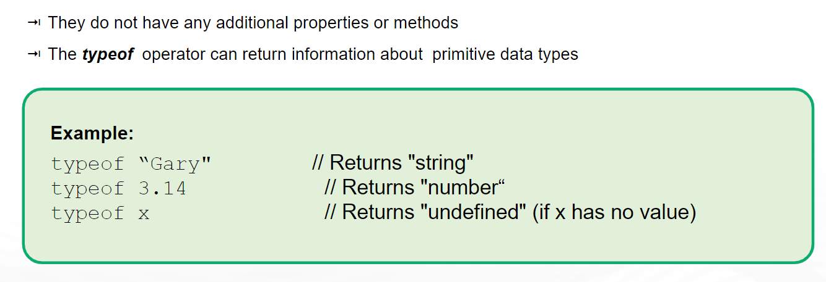
Primitive Data Types

Slide 30
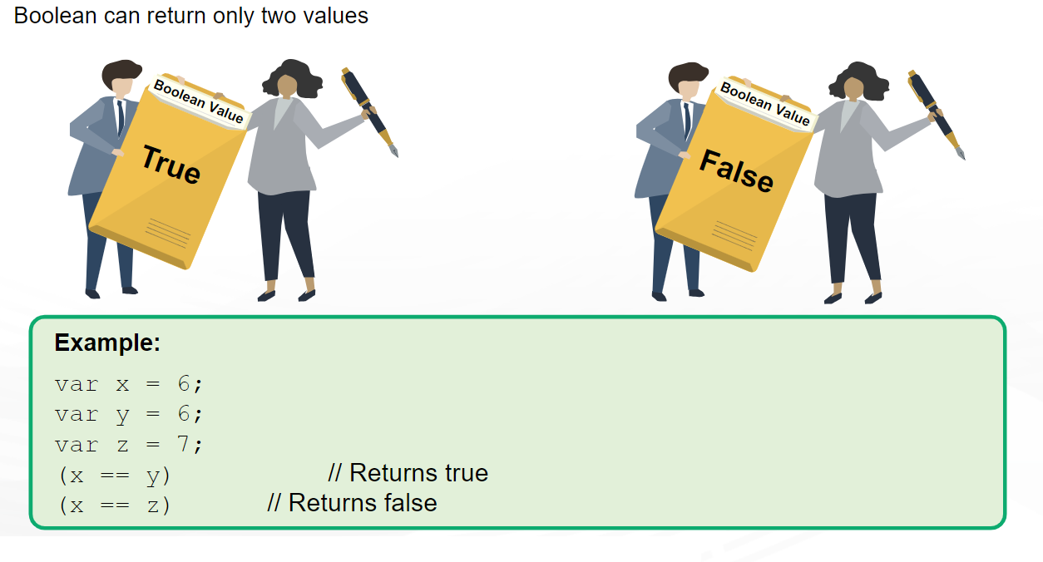
Primitive Data Types : Boolean

Slide 31
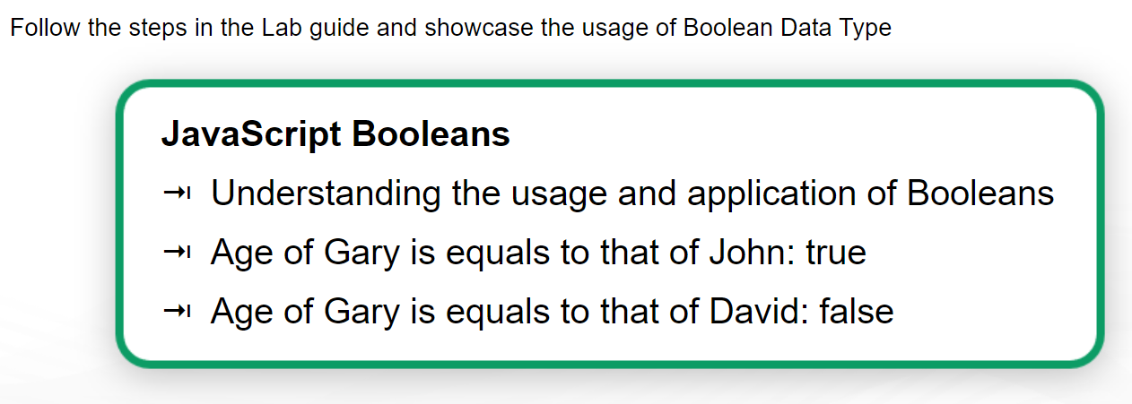

Slide 32
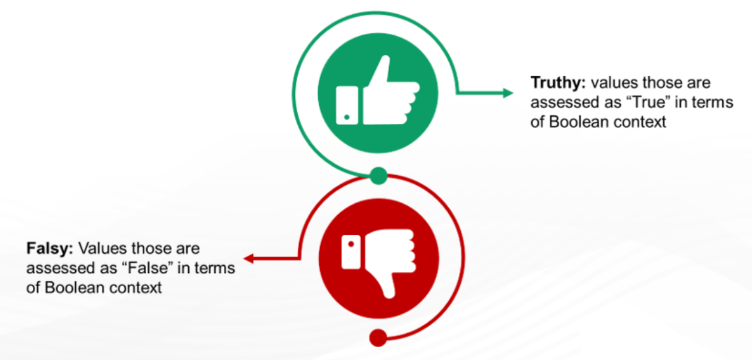
Truth and False values

Slide 33
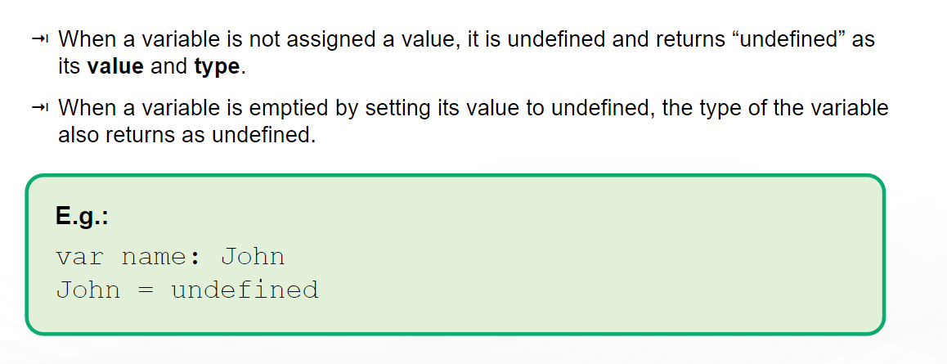
Undefined

Slide 34
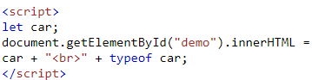
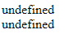
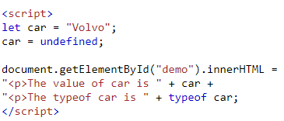
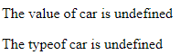
Undefined
In JavaScript, a variable without a value, has the value undefined. The type is also undefined.
Any variable can be emptied, by setting the value to undefined. The type will also be undefined.

Slide 35
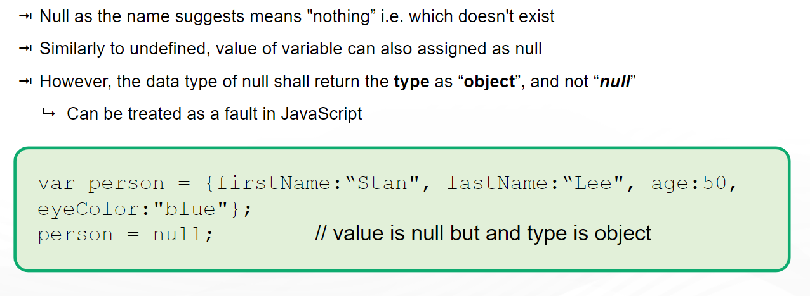
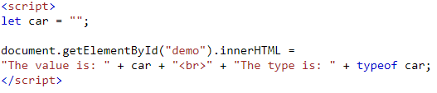
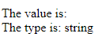
null

Slide 36
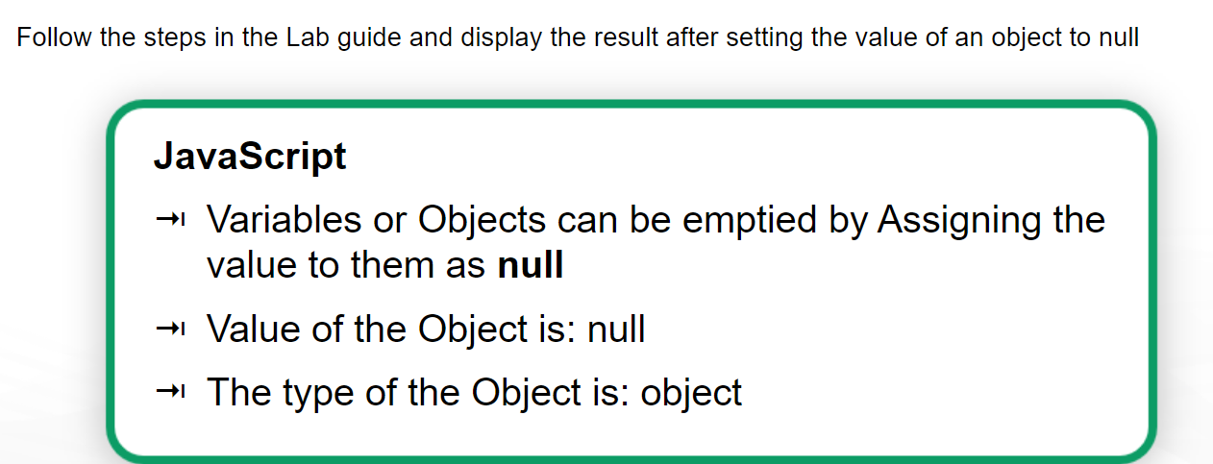

Slide 37
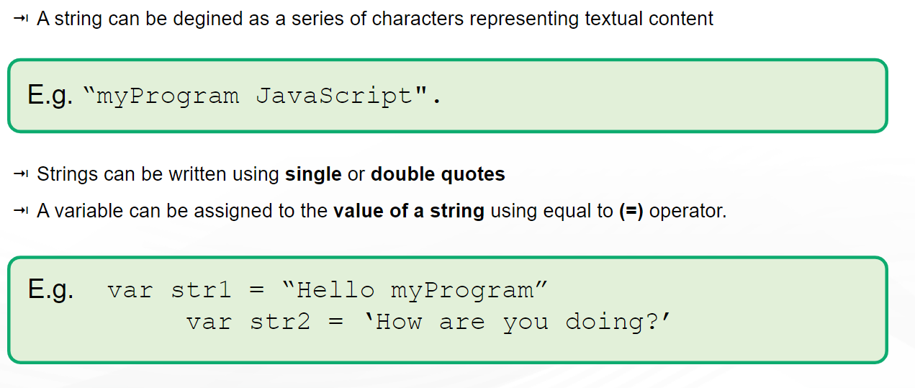
Strings

Slide 38
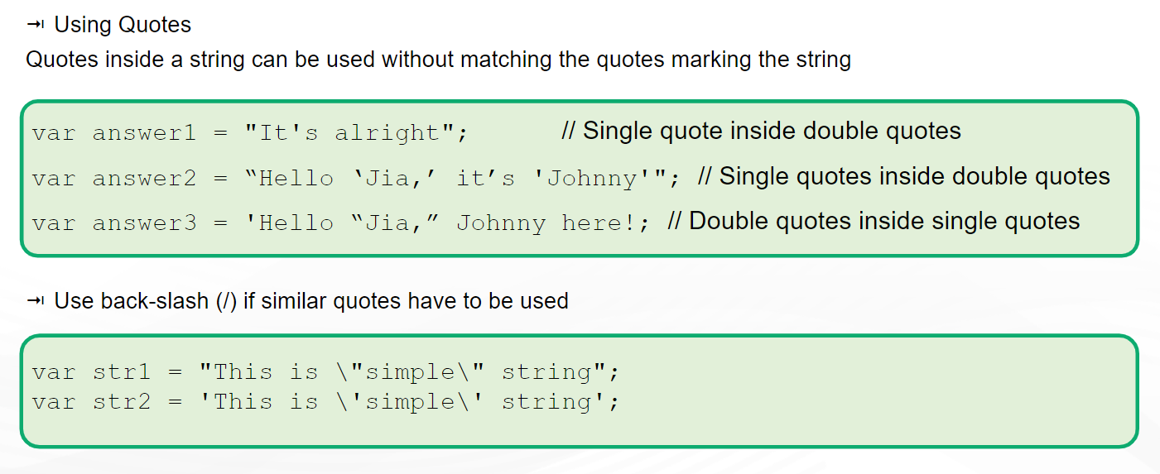
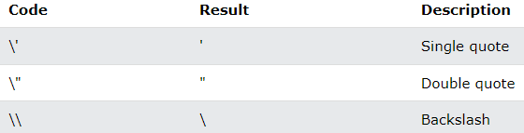
String

Slide 39
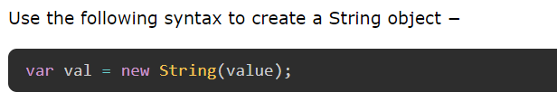
String
JavaScript strings can also be created as objects using the String() constructor.
The String parameter, value is a series of characters that has been properly encoded.
We can also create string using String() function as follows −

Slide 40
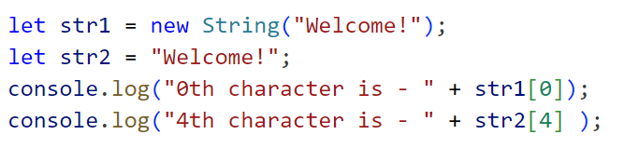
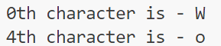


Accessing a string : We can access the string characters using its index. The string index starts from 0.
JavaScript string is case-sensitive: In JavaScript, strings are case-sensitive. It means lowercase and uppercase characters are different.
JavaScript Strings Are Immutable: In JavaScript, you can't change the characters of the string. However, you can update the whole string.

Slide 41
Javascript strings are primitive and immutable: All string methods produce a new string without altering the original string.
Basic String Methods
String length
String charAt()
String charCodeAt()
String at()
String [ ]
String slice()
String substring()
String substr()
String toUpperCase()
String toLowerCase()
String concat()
String trim()
13) String trimStart()
14) String trimEnd() 15) String padStart() 16) String padEnd() 17) String repeat() 18) String replace() 19) String replaceAll() 20) String split()

Slide 42



String Methods
length: Returns the length of a string.
charAt(index) : Returns the character at a specified index.
slice(start, end) : Extracts a part of a string and returns it as a new string. The end index is not included.

Slide 43



toUpperCase() and toLowerCase(): Converts a string to upper or lower case.
trim() : Removes whitespace from both ends of a string.
split(separator)Description: Splits a string into an array of substrings based on a separator.

Slide 44

Strings Method – Concatenating Strings

Slide 45

Strings Method – Finding a String within String

Slide 46


Slide 47
Extracting String Characters
There are 4 methods for extracting string characters:
The at(position) Method: returns the character at a specified index (position) in a string. supported in all modern browsers since March 2022. It allows the use of negative indexes while charAt() do not.
The charAt(position) Method: returns the character at a specified index (position) in a string
The charCodeAt(position) Method: returns the code of the character at a specified index in a string. The method returns a UTF-16 code (an integer between 0 and 65535)
Using property access [] like in arrays
Property access might be a little unpredictable:
It makes strings look like arrays (but they are not)
If no character is found, [ ] returns undefined, while charAt() returns an empty string.
It is read only. str[0] = "A" gives no error (but does not work!)

Slide 48





charAt(position)
charCodeAt(position)
at(position)
property access []

Slide 49






Extracting String Parts
There are 3 methods for extracting a part of a string:
1. slice(start, end): extracts a part of a string and returns the extracted part in a new string. JavaScript counts positions from zero.
If you omit the second parameter, the method will slice out the rest of the string.
If a parameter is negative, the position is counted from the end of the string.

Slide 50


2. substring(start, end): is similar to slice. The difference is that start and end values less than 0 are treated as 0 in substring()
3. substr(start, length): is similar to slice. The difference is that the second parameter specifies the length of the extracted part.
If you omit the second parameter, substr() will slice out the rest of the string.
If the first parameter is negative, the position counts from the end of the string.

Slide 51


String toUpperCase(): A string is converted to upper case
String toLowerCase(): A string is converted to lower case
String concat(): joins two or more strings
String trim(): removes whitespace from both sides of a string
String trimStart(): works like trim(), but removes whitespace only from the start of a string
String trimEnd(): works like trim(), but removes whitespace only from the end of a string
String padStart(): pads a string from the start. It pads a string with another string (multiple times) until it reaches a given length.
String padEnd(): pads a string from the end. It pads a string with another string (multiple times) until it reaches a given length.
String repeat(): returns a string with a number of copies of a string. returns a new string. does not change the original string.

Slide 52



Replacing String Content: replaces a specified value with another value in a string. replace() method is case sensitive. replaces only the first match.

Slide 53



To replace case insensitive, use a regular expression with an /i flag (insensitive):

Slide 54



To replace all matches, use a regular expression with a /g flag (global match):

Slide 55


String ReplaceAll(): allows you to specify a regular expression instead of a string to be replaced. If the parameter is a regular expression, the global flag (g) must be set, otherwise a TypeError is thrown.

Slide 56


String split(): A string can be converted to an array with the split() method.
If the separator is omitted, the returned array will contain the whole string in index [0].
If the separator is "", the returned array will be an array of single characters:

Slide 57

Number

Slide 58






JavaScript uses the + operator for both addition and concatenation. Numbers are added. Strings are concatenated.

Slide 59


Slide 60


Slide 61

Number Methods – Returning Numbers

Slide 62

Number Methods – Returning Numbers

Slide 63

Non-primitive Data Type

Slide 64


Objects

Slide 65

Creating an Object:
The person object has properties like firstName, lastName, age, and isStudent, as well as a method greet().

Slide 66
Accessing Object Properties
Dot Notation
Bracket Notation:

Slide 67



Modifying Object Properties
Updating Property Values:
Adding New Properties:
Deleting Object Properties
Methods in Objects

Slide 68

Array

Slide 69

Array

Slide 70

Date

Slide 71


Slide 72


Slide 73

JavaScript Operators

Slide 74

Arithmetic Operators

Slide 75

Assignment Operators

Slide 76

Comparison Operator

Slide 77

Understanding Operators: (=), (==) and (===)

Slide 78

In JavaScript, == and === are comparison operators used to check equality between two values or variables.
The main difference between the two operators is how they compare values. The == operator compares the values of two variables after performing type conversion if necessary. On the other hand, the === operator compares the values of two variables without performing type conversion.

Slide 79

Logical Operator

Slide 80

JavaScript Bitwise Operators

Slide 81
JavaScript Control Flow
Control flow refers to the order in which individual statements, instructions, or function calls are executed or evaluated in a programming language.
It allows you to control the decision-making process in your code, executing different blocks of code based on conditions.

Slide 82


If…else
JavaScript supports the following forms of if...else
statement −
if statement
if...else statement
if...else if... statement.
1. If statement:

Slide 83



Slide 84



If..else

Slide 85

If..else..if statement

Slide 86



Slide 87


Nested if..else

Slide 88
Loop: for & while
A loop is a programming structure that repeats a block of code as long as a specified condition is true.
Types of Loops in JavaScript
for Loop
while Loop
do...while Loop
for...in Loop
for...of Loop

Slide 89

for loop
The JavaScript for loop is used to execute a block of code
repeatedly, until a specified condition evaluates to false.
It includes the following three important parts −
Initialization − The loop initialization expression is where we initialize our counter to a starting value. The initialization statement is executed before the loop begins.
Condition − The condition expression which will test if a given condition is true or not. If the condition is true, then the code given inside the loop will be executed. Otherwise, the control will come out of the loop.
Iteration − The iteration expression is where you can increase or decrease your counter.

Slide 90




Slide 91




While loop

Slide 92



do...while loop

Slide 93

for..in loop
The for...in loop in JavaScript is used to loop through an object's properties
Parameters
variableName − It is a property name (key) of the object.
in − It is an 'in' operator in JavaScript.
object − It is the object to traverse.

Slide 94



Slide 95

for..of
The for...of loop is used to iterate over iterable objects like arrays, strings, maps, sets, etc.
Parameters
ele − It is a current element of the iterable.
of − It is a JavaScript operator.
iterable − It is iterable like an object, array, string, etc.

Slide 96



Slide 97



for..in looping over array

Slide 98

for..of looping over a String

Slide 99


Break and Continue
The break statement in JavaScript terminates the loop or switch case statement.
When the break statement is used with the loop, the control flow jumps out of the loop and continues to execute the other code.

Slide 100


The continue statement in JavaScript is used to skip the current iteration of a loop and continue with the next iteration.
It is often used in conjunction with an if statement to check for a condition and skip the iteration if the condition is met.

Slide 101

Switch
The switch statement is a control flow statement that allows you to execute one block of code among many based on the value of an expression.
It simplifies complex if...else if chains by making the code easier to read and maintain.
expression: The value being compared.
case: A possible value that the expression could match.
break: Terminates the switch statement, preventing the execution of subsequent cases.
default: Optional; executed if no case matches the expression.

Slide 102


Slide 103

JavaScript Functions

Slide 104

Syntax of JS function

Slide 105

Using Functions as Variable Values

Slide 106

Function Expressions
The function expression allows us to define a JavaScript function in an expression
The function name can be omitted in function expressions.
This helps to create anonymous functions in JavaScript.
Syntax: function (parameter-list) {
statements
};
Once the function is assigned to a variable, the variable is used to invoke the function.

Slide 107

Immediately Invoked Function Expression(IIFE)
An IIFE is a function that runs as soon as it is defined.
Syntax:
(function() {
// Function body
})();

Slide 108


Arrow functions
An arrow function expression has a shorter syntax compared to function expressions.
Arrow functions are always anonymous.

Slide 109

If the function has a single expression, you can omit the curly braces and the return keyword.

Slide 110

Using Variables as Local/Global

Slide 111

Limited Scope of Local Variable

Slide 112
JavaScript Array
Arrays are ordered collections of elements that can store multiple values in a single variable.
let fruits = ["apple", "banana", "mango"];
Return value : It returns an array object.
Accessing Elements:
fruits[0] is the first element
fruits[1] is the second element
fruits[2] is the third element
Modifying Elements: fruits[1] = "orange"; // Changes "banana" to "orange"

Slide 113
Array Properties and Methods
length: Returns the number of elements in an array.
console.log(fruits.length); // Outputs 3
push(): Adds elements to the end of an array
fruits.push("grape");
pop(): Removes the last element from an array
fruits.pop();
fill(): fill all the elements of an array with a specified value.
fruits.fill("Kiwi");
indexOf(): Returns the first (least) index of an element within the array equal to the specified value, or -1 if none is found.
reverse() : Reverses the order of the elements of an array -- the first becomes the last, and the last becomes the first.
Fruits.reverse();
slice() : Extracts a section of an array and returns a new array.
array.slice(start, end);

Slide 114


Sorting Arrays
Array.sort() method sorts the elements of an array in place and returns the sorted array.
This method accepts only one parameter, which is described below −
CompareFunction − This is a function that defines the sort order of the array elements. This function takes two parameters (A and B) representing two elements in the array for comparison.
If (A – B) < 0, a negative value, then A comes first.
If (A – B) = 0, then nothing will be changed.
If (A – B) > 0, a positive value, then B comes first.

Slide 115


Slide 116


Joining Arrays
Array join() method is used to concatenate the array elements with a specified separator and returns the result as a string.
If no separator is specified, the array elements will be separated by (,) comma by default.
This method does not change the original array instead, it returns a new string as a result.
If the array has only one item, then the value will be returned without a separator.

Slide 117


concat() : returns a new array comprised of this array joined with another array (s) and/or value(s).

Slide 118

Reduce & map
Array.reduce() method is used to manipulate array.
This method executes a reducer function on each element of the array (from left to right) and returns a 'single value' as a result.
This method accepts two parameters. The same is described below −
callbackFn − This is the function to execute on each element in the array. This function takes four arguments:
accumulator − This is the initialValue, or the previously returned value of the function.
currentValue − This is the current element being processed in the array. If the initialValue is specified, its value will be arr[0], if not it's value will be arr[1].
currentIndex (optional) − This is the index of the current element being processed in the array.
array (optional)− This is the array on which the reduce() method is called.
initialValue (optional) − The value to which the accumulator parameter is initialized when the first time the callback function is called.
If the current array is empty or doesn't contain any initialValue, this method will throw a 'TypeError' exception

Slide 119



Slide 120

Array.map() method creates a new array by applying a provided function on each element of the original array.
It doesn't modify the original array instead; it returns a new array with the results of applying the provided function to each element.
This method does not execute the function for empty array elements.
This method accepts two parameters. The same is described below −
callbackfn − This is a callback function that will be called once for each element in the array. It further takes three arguments:
element − The current element being processed in the array.
index − The index of the current element being processed.
array − The array of the current element.
thisArg (optional) − It specifies a value passed to the function to be used as its this value.

Slide 121



Slide 122

JavaScript Document Object Model (DOM)
The Document Object Model (DOM) is a programming interface for HTML documents.
It represents the page structure as a tree of objects, allowing developers to manipulate content, structure, and styles of a document dynamically.
JavaScript can change all HTML elements, attributes, CSS styles in the page.
It is a W3C (World Wide Web Consortium) standard.
Document: Represents the entire HTML document.
Nodes: Everything in an HTML document is a node (elements, attributes, text).
Tree Structure: The DOM is structured as a hierarchical tree of nodes, with the document object at the root.

Slide 123
With the object model, JavaScript gets all the power it needs to create dynamic HTML:
JavaScript can change all the HTML elements in the page
JavaScript can change all the HTML attributes in the page
JavaScript can change all the CSS styles in the page
JavaScript can remove existing HTML elements and attributes
JavaScript can add new HTML elements and attributes
JavaScript can react to all existing HTML events in the page
JavaScript can create new HTML events in the page

Slide 124
DOM Methods
DOM methods are used to perform a particular action on HTML elements.
In the tree, each branch ends in a node, and each node contains objects.
DOM methods allow us programmatic access to the tree.
Using the DOM methods, you can change the document's structure, style, or content.

Slide 125

JavaScript HTML DOM Elements

Slide 126

Finding HTML Element by Id

Slide 127





Slide 128

Finding HTML Element by Tag Name

Slide 129



Slide 130



Slide 131

Finding HTML Element by Class Name

Slide 132

Finding HTML Element by CSS Selector
querySelector() is used to select the first element that matches the css selector passed as an argument.
Use “#” with id selector and “.” with class selector.
querySelectorAll() is use selects all elements that match a CSS selector.
Both throw a SYNTAX_ERR exception if the selector(s) is invalid.

Slide 133



Manipulating the DOM
textContent: This property is used to get or set the text content of the specified node and its descendants.

Slide 134



Slide 135


innerHTML: This property is used to get or set the HTML content of an element.

Slide 136



Slide 137
The Differences Between innerHTML, innerText and textContent
The innerHTML property returns: The text content of the element, including all spacing and inner HTML tags.
The innerText property returns: Just the text content of the element and all its children, without CSS hidden text spacing and tags, except <script> and <style> elements.
The textContent property returns: The text content of the element and all descendants, with spacing and CSS hidden text, but without tags.

Slide 138




Slide 139

Changing Attributes
setAttribute(): Adds or changes an attribute of an element.
Sets a new value to an attribute.
If the attribute does not exist, it is created first.

Slide 140




Slide 141

getAttribute(): Gets the value of an attribute of an element.

Slide 142

removeAttribute(): Removes an attribute from an element.

Slide 143
Adding and Removing Elements
createElement(): Creates a new element.
let newDiv = document.createElement("div");
appendChild(): Adds a new child node to an element.
let parentElement = document.getElementById("parent");
parentElement.appendChild(newDiv);
insertBefore(): Inserts a new node before an existing node.
let parent = document.getElementById("parent");
let child = document.getElementById("child");
parent.insertBefore(newDiv, child);
removeChild(): Removes a child node from an element
let parent = document.getElementById("parent");
let child = document.getElementById("child");
parent.removeChild(child);

Slide 144
JavaScript Events
HTML DOM allows JavaScript to react to HTML events
A JavaScript can be executed when an event occurs, like when a user clicks on an HTML element.
Events are things that happen in the system you are programming — the system produces (or "fires") a signal of some kind when an event occurs.
Examples of HTML events:
When a user clicks the mouse
When a web page has loaded
When an image has been loaded
When the mouse moves over an element
When an input field is changed
When an HTML form is submitted
When a user strokes a key

Slide 145
Event Handling
To react to an event, an event handler is attached to it.
This is a block of code that runs when the event fires.
Note: Event handlers are sometimes called event listeners — they are pretty much interchangeable.
addEventListener(): Attaches an event handler to an element.

Slide 146


An example: handling a click event
The HTML <button> element will fire an event when the user clicks the button.
It is fine to make the handler function a separate named function, like this:

Slide 147
Event Types
click: Triggered when an element is clicked.
mouseover: Triggered when the mouse hovers over an element.
mouseout: Triggered when the mouse leaves an element.
keydown: Triggered when a key is pressed down.
submit: Triggered when a form is submitted.
dblclick —when the element is double-clicked.

Slide 148
Removing Event Listeners:
removeEventListener(): Removes an event handler from an element
button.removeEventListener("click", clickHandler);

Slide 149
Adding multiple listeners for a single event
By making more than one call to addEventListener(), providing different handlers, we can have multiple handlers for a single event:
myElement.addEventListener("click", functionA);
myElement.addEventListener("click", functionB);
Both functions would now run when the element is clicked.

Slide 150
Other event listener mechanisms
It is recommend to use addEventListener() to register event handlers.
It's the most powerful method and scales best with more complex programs.
However, there are two other ways of registering event
event handler properties and
inline event handlers.

Slide 151

Event handler properties
Objects (such as buttons) that can fire events also usually have properties whose name is on followed by the name of the event.
For example, elements have a property onclick.
With event handler properties, we can't add more than one handler for a single event.

Slide 152
Inline event handlers [— don't use these]
<!DOCTYPE html> <html> <body> <h1 onclick="changeText(this)">Click on this text!</h1> <script> function changeText(id) { id.innerHTML = "Ooops!"; } </script> </body> </html>

Slide 153

Integrating JavaScript with CSS
JavaScript allows you to dynamically manipulate CSS styles, enabling interactive and responsive user interfaces.
You can change the appearance of elements based on user actions (e.g., clicks, hovers).
Element's styles can be modify using JavaScript by targeting the style property of a DOM element.
document.getElementById("myElement").style.color = "red";
Changing Multiple Styles:
let element = document.getElementById("myElement");
element.style.backgroundColor = "yellow";
element.style.fontSize = "20px";
element.style.margin = "10px";

Slide 154



Changing Style of the Element When Event Triggers
On click

Slide 155
HTML5: Drag and Drop
Drag and Drop is a feature in HTML5 that allows users to click on an element, drag it to a different location, and drop it.
This functionality can be used for a variety of applications, such as rearranging items, moving files, or creating interactive user interfaces.
Draggable Elements: Elements that can be dragged.
Drop Target: The element where the draggable item can be dropped.
draggable: An HTML attribute that makes an element draggable.
<img src="image.png" draggable="true" />

Slide 156
Drag and Drop Events
dragstart: Fired when the drag operation begins.
drag: Fired while the element is being dragged.
dragenter: Fired when the dragged element enters a drop target.
dragover: Fired when the dragged element is over a drop target.
Important: Prevent the default behavior to allow dropping.
dragleave: Fired when the dragged element leaves a drop target.
drop: Fired when the dragged element is dropped on a drop target.
target.addEventListener("drop", function(event) {
event.preventDefault(); // Prevent default action (e.g., opening a link)
let data = event.dataTransfer.getData("text");
// Code to handle the dropped data });
dragend: Fired when the drag operation ends.

Slide 157
<body>
<div id="drag1" draggable="true" style="width: 100px; height: 100px; background-color: blue;"></div>
<div id="dropZone" style="width: 300px; height: 300px; border: 2px dashed black;"></div>
<script>
let dragItem = document.getElementById("drag1");
let dropZone = document.getElementById("dropZone");
dragItem.addEventListener("dragstart", function(event) {
event.dataTransfer.setData("text", event.target.id); });
dropZone.addEventListener("dragover", function(event) {
event.preventDefault(); // Necessary to allow a drop });
dropZone.addEventListener("drop", function(event) {
event.preventDefault();
let data = event.dataTransfer.getData("text");
let draggedElement = document.getElementById(data);
event.target.appendChild(draggedElement); });
</script> </body>

Slide 158
HTML5 canvas
The HTML5 <canvas> element is used to draw graphics, animations, and render images on a web page using JavaScript.
It provides a 2D drawing surface that can be manipulated for dynamic, interactive content.
<canvas> Tag:The canvas element defines a drawing area in your HTML document.
<canvas id="myCanvas" width="500" height="400"></canvas>
Accessing the Canvas via JavaScript: To draw on the canvas, JavaScript is used to access the rendering context
let canvas = document.getElementById("myCanvas");
let context = canvas.getContext("2d"); // Get the 2D drawing context

Slide 159
<!DOCTYPE html>
<html lang="en">
<head>
<meta charset="UTF-8">
<meta name="viewport" content="width=device-width, initial-scale=1.0">
<title>Document</title>
</head>
<body>
<canvas id="canvas" width="500" height="400"></canvas>
<script>
const canvas = document.getElementById("canvas");
const ctx = canvas.getContext("2d");
ctx.fillStyle = "green";
ctx.fillRect(10, 10, 150, 100);
</script>
</body>
</html>

Slide 160
HTML5 Local Storage
HTML5 Local Storage is a web storage feature that allows websites to store data in a user's browser with no expiration date.
This data persists even after the browser is closed and can be retrieved later when the user revisits the website.
Usually around 5-10 MB per origin (domain).
localStorage is similar to sessionStorage, except that while localStorage data has no expiration time, sessionStorage data gets cleared when the page session ends — that is, when the page is closed.

Slide 161
Key Characteristics of Local Storage
Data Persistence: Data is not cleared when the browser is closed, unlike session storage.
Storage Limit: Typically much larger than cookies (5MB or more).
Accessibility: Accessible via JavaScript and stored in key-value pairs.
No Expiration: Data remains stored until manually cleared by the user or script.
Client-Side Only: Data is stored on the user's browser, not sent to the server with each HTTP request (unlike cookies).

Slide 162
Syntax for Using Local Storage
Setting Data in Local Storage: localStorage.setItem(key, value)
localStorage.setItem('username', 'JohnDoe');
Retrieving Data from Local Storage: localStorage.getItem(key)
let userName = localStorage.getItem('username');
console.log(userName); // Output: JohnDoe
Removing Data from Local Storage: localStorage.removeItem(key)
localStorage.removeItem('username');
Clearing All Data in Local Storage:localStorage.clear()
localStorage.clear(); // Clears all local storage data

Slide 163




Slide 164
Feature | Local Storage | Cookies
Data Limit | 5MB (or more) | 4KB
Persistence | Until manually cleared | Can be set to expire
Access Scope | Client-side only | Sent with each request
Accessibility | JavaScript | JavaScript, HTTP
Security | Vulnerable to XSS | Secure, HttpOnly flags

Slide 165
HTML5 web workers
Web Workers provide a way to run scripts in the background, on a separate thread from the main execution thread of a web page.
When executing scripts in an HTML page, the page becomes unresponsive until the script is finished.
A web worker is a JavaScript that runs in the background, independently of other scripts, without affecting the performance of the page.
They allow complex operations (like data processing) to be performed without blocking the main UI thread, improving performance.

Slide 166
<body>
<h2>Web Worker Example</h2>
<button onclick="startWorker()">Start Worker</button>
<p id="result"></p>
<script>
let worker;
function startWorker() {
if (window.Worker) {
worker = new Worker('worker.js');
worker.postMessage('Process this data'); // Send message to worker
worker.onmessage = function(event) {
document.getElementById('result').innerText = event.data; // Display worker's response
};
}
}
</script>
</body>

Slide 167
HTML5 server sent events
Server-Sent Events (SSE) allow a web page to automatically receive updates from a server in real-time over an HTTP connection.
Traditionally, a web page has to send a request to the server to receive new data; that is, the page requests data from the server.
With server-sent events, it's possible for a server to send new data to a web page at any time, by pushing messages to the web page.

